Slide 1
Baby Cry Detector Report
Zhijian Wang
Zhijian.Wang@intel.com
wangzhijian22@gmail.com

Slide 2
Flowchart

Slide 3
System Structure

Slide 4
Tool-function#1 enframe
Split the voice data into frames
Input:
original voice data
frame length
frame shift/increment
Output:
arrays of frames

Slide 5
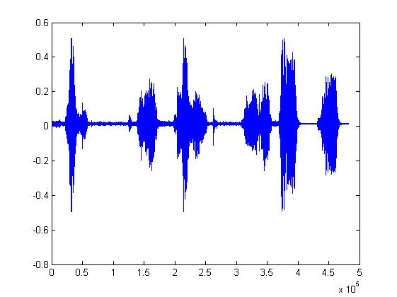
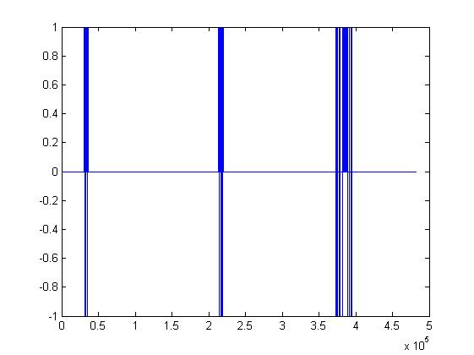
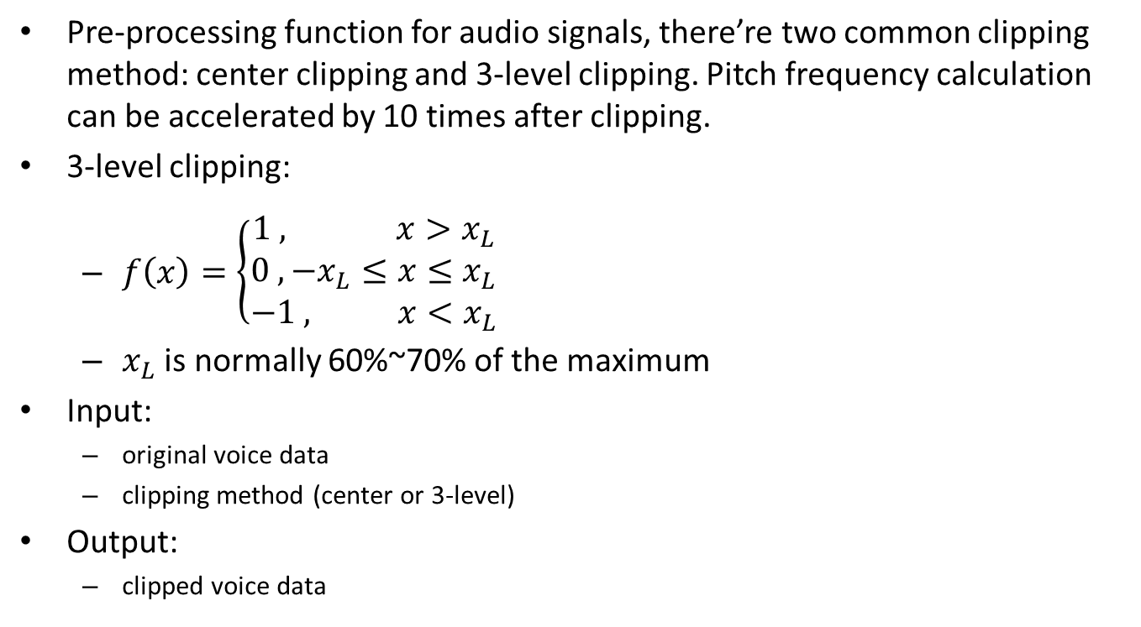
Tool-function#2 clipping
Pre-processing function for audio signals, there’re two common clipping method: center clipping and 3-level clipping. Pitch frequency calculation can be accelerated by 10 times after clipping.
3-level clipping:
$f\left(x\right)=\left\{\begin{aligned}1 , x>x_{L} \\ 0 , −x_{L}≤x≤x_{L} \\ −1 , x<x_{L}\end{aligned}\right.$
$x_{L}$ is normally 60%~70% of the maximum
Input:
original voice data
clipping method (center or 3-level)
Output:
clipped voice data

Slide 6
Tool-function#3 FIR
FIR low pass filter.
Since human voice (include baby cry) frequency is always below 3000Hz, we only care about those voice signals going through a low pass filter with a cutoff frequency of 3000Hz. This is why the sampling frequency of the phone is 8KHz.
Input:
original voice data
cutoff frequency
Output:
filtered voice data

Slide 7
Tool-function#4 linsmooth
A linear smoothing function to eliminate the ‘wild points’ of a dataset.
In our system, we use another kind of smoothing method called median smoothing due to their efficiency. They can also be combined to form other smoothing methods. I didn’t do a result-accuracy experiment on this smoothing thing, so this linear smoothing function is still provided here for future work, research or optimization.
Input:
original dataset
smoothing window length
Window type (hanmming as default)
Output:
smoothed dataset

Slide 8
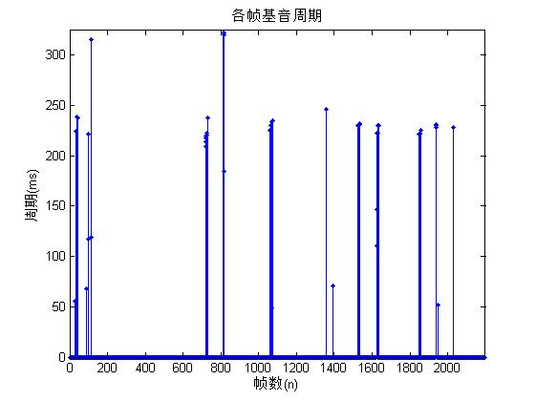
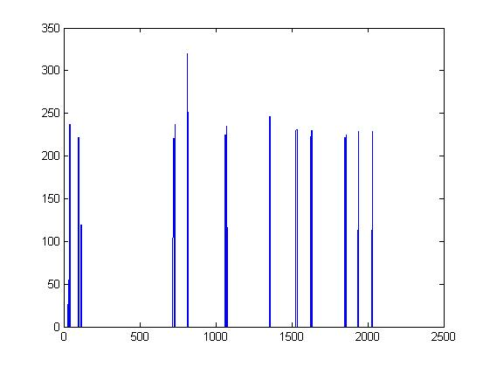
Tool-function#5 smoothing
Post-processing function for pitch frequency feature extraction.
Use this smoothing function to eliminate the wild points.
In detail, I use the composition of 3-point median smoothing method and 5-point median smoothing method.
Input:
original pitch frequency dataset
Output:
smoothed pitch frequency dataset

Slide 9
Tool-function#6 vad
Voice Activity Detection (Endpoint detection) function
This function is used to find the start point and the end point of the voice signal.
I don’t use this in this system, but still provided here in case of future work ,research or optimization.
Input:
original voice data
frame length
frame shift/increment
Output:
voice activity start point
voice activity end point

Slide 10
Tool-function#7 zcro
Function for zero-crossing rate calculation.
This function is used to calculate the zero-crossing rate of each signal frame.
Input:
voice frames
Output:
zero-crossing ratio of each frame

Slide 11
Feature Extraction functions
Names of the feature extraction functions in this system all start with a capital letter. They have the same input, and one feature-value as output (the STE has two feature-values).
They are:
Freq : For frequency-related feature extraction
PitchFreq: For pitch-frequency-related feature extraction
STE: For short-time-energy-related feature extraction
ZCR: For zero-crossing-ratio-related feature extraction
Input:
original voice data
sampling frequency of the voice signal (In the monitor module, we record with a frequency of 8KHz)
sampling bits of the voice signal
Output:
one or two value/values for the corresponding feature

Slide 12
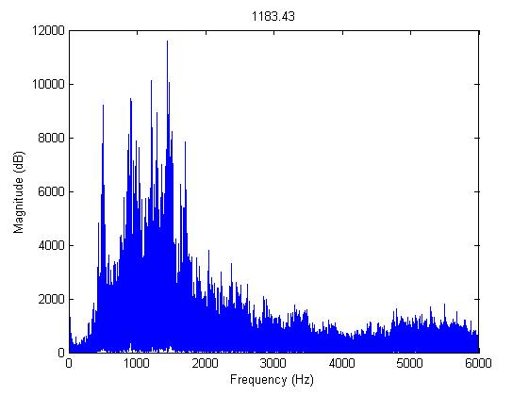
Feature#1 Frequency
Human voice is mainly made up of the frequency range from 85Hz ~ 255Hz. Sometimes the soprano can arrive 700-1000Hz. For baby cry, the most of the voice stays over 1000Hz.
Use frequency spectrum to see the distribution of the voice frequency.

Slide 13
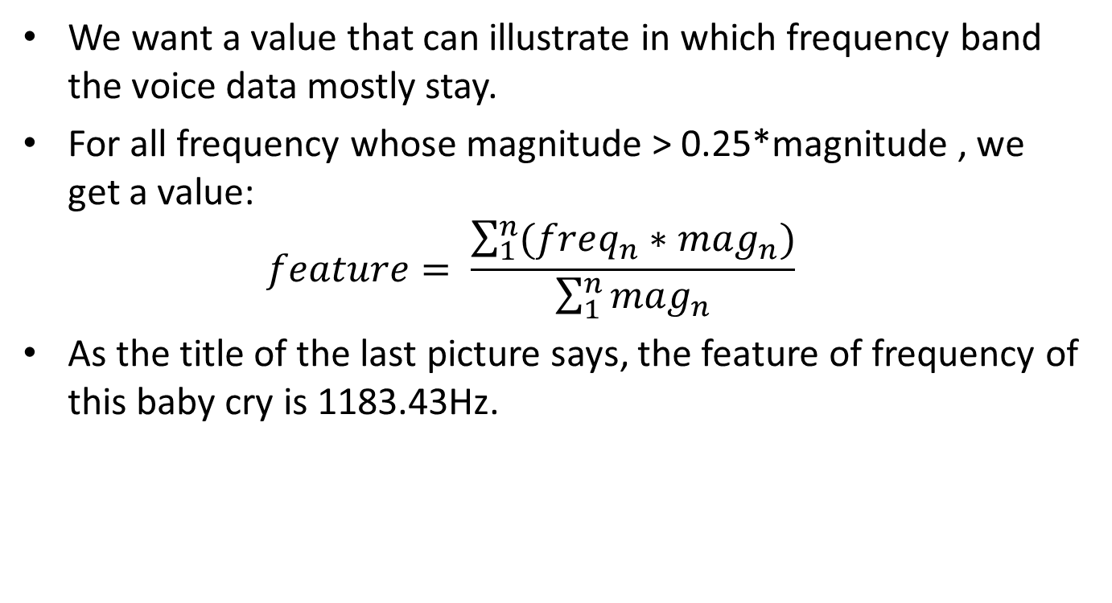
Feature#1 Frequency
We want a value that can illustrate in which frequency band the voice data mostly stay.
For all frequency whose magnitude > 0.25*magnitude , we get a value: $feature= \frac{\sum_{1}^{n}{(freq_{n}∗mag_{n})}}{\sum_{1}^{n}{mag_{n}}}$
As the title of the last picture says, the feature of frequency of this baby cry is 1183.43Hz.

Slide 14
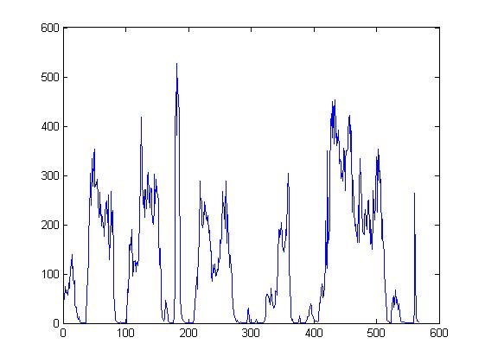
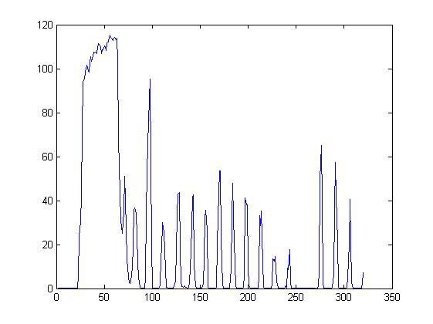
Feature#2 Short-Time Energy
Energy of 浊音 signals is much bigger than that of 清音 signals. A Baby’s cry is usually the former one.
This feature is not so important, because adults can produce 浊音 with very high energy. And baby cry’s energy is not so high sometimes.

Slide 15
Feature#3 Max STE Acceleration
Due to the burst of the baby cry, the STE of the cry signal can arrive a very high value in just one or two frames.
Here are the max-accs of 20 baby cry samples. Some baby cry samples have a low value of max-acc because the cry is very smooth.
Here are the max-accs of 5 adult voice samples. Some adult voice samples have a high value of max-acc because of the instantaneous bursts.

Slide 16
Feature#4 Pitch Frequency
Pitch Frequency is one of the most important feature of human voice. For ref, http://en.wikipedia.org/wiki/Pitch_detection_algorithm
The fundamental frequency of speech can vary from 40 Hz for low-pitched male voices to 600 Hz for children or high-pitched female voices.
As I mentioned in the previous page, we use 3-level clipping to reduce the calculation of pitch frequency.
After clipping, we use short-time-autocorrelation methods to calculate the pitch frequency of each frame.

Slide 17
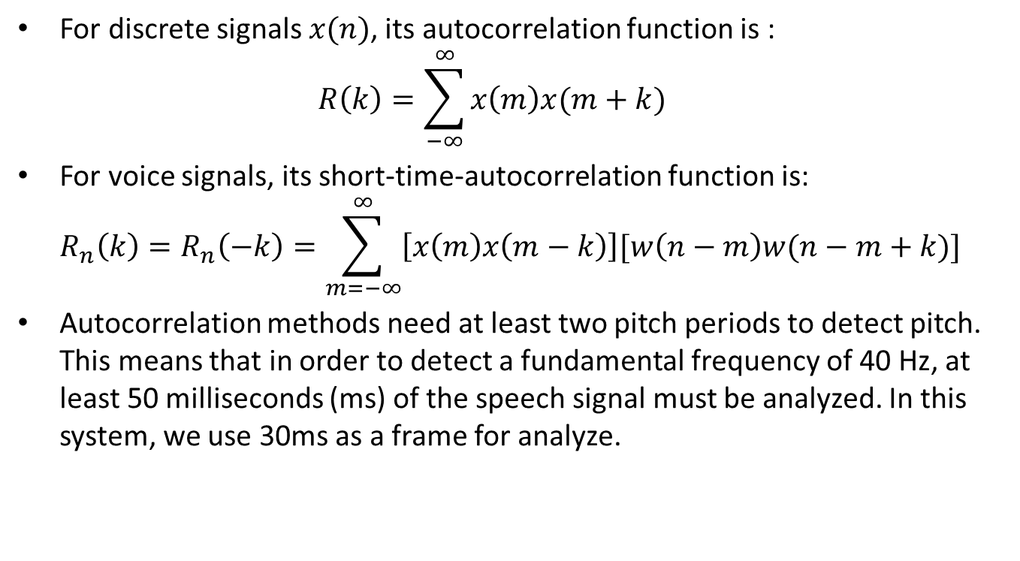
Feature#4 Pitch Frequency
For discrete signals $x(n)$, its autocorrelation function is : $R\left(k\right)=\sum_{−∞}^{∞}{x\left(m\right)x(m+k)}$
For voice signals, its short-time-autocorrelation function is: $R_{n}\left(k\right)=R_{n}\left(−k\right)=\sum_{m=−∞}^{∞}{\left[x\left(m\right)x\left(m−k\right)\right][w\left(n−m\right)w(n−m+k)]}$
Autocorrelation methods need at least two pitch periods to detect pitch. This means that in order to detect a fundamental frequency of 40 Hz, at least 50 milliseconds (ms) of the speech signal must be analyzed. In this system, we use 30ms as a frame for analyze.

Slide 18
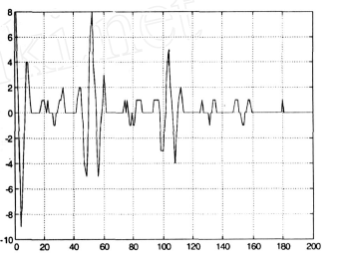
Feature#4 Pitch Frequency
Pitch frequency estimation. As the pic below shows, the first pitch of this frame arrives at about 50, so the pitch frequency of this frame is (8000/50=160Hz), 8000 is the sampling frequency of the voice signal.
For every frame, we must discard the first several samples due to signal disturbance. In this system, I discard the samples of the first 10% of each frame, that is 3ms*8KHz=24 samples.
After getting the pitch of the frame, we need another test. If the pitch value is smaller than 0.25*STE-of-this-frame, then we consider this frame as 清音, and set its pitch frequency to 0.

Slide 19
Feature#4 Pitch Frequency
Post-processing. As I mentioned in the previous page, after getting the pitch frequency of each frame, we’d better do a smoothing work to eliminate the wild points.

Slide 20
Feature#4 Pitch Frequency
For this feature, what we care about is, how many frames of the voice signal arrive a pitch frequency over 200.
In this system, if more than 5 frames of the voice signal arrive a frequency over 200, then this voice has a higher possibility to be a baby cry.

Slide 21
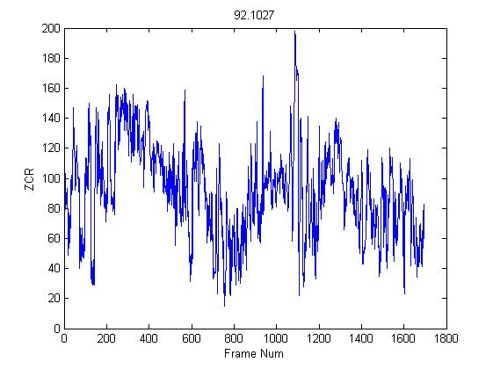
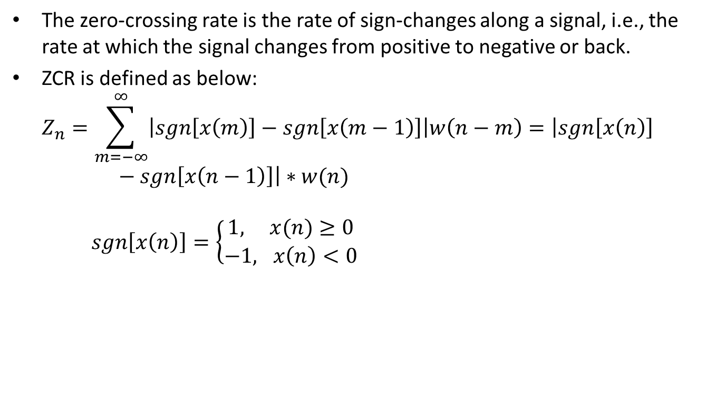
Feature#5 Zero-crossing rate
The zero-crossing rate is the rate of sign-changes along a signal, i.e., the rate at which the signal changes from positive to negative or back.
ZCR is defined as below: $Z_{n}=\sum_{m=−∞}^{∞}{\left|sgn\left[x\left(m\right)\right]−sgn\left[x\left(m−1\right)\right]\right|w\left(n−m\right)=\left|sgn\left[x\left(n\right)\right]−sgn\left[x\left(n−1\right)\right]\right|∗w(n)}$ $sgn\left[x\left(n\right)\right]=\left\{\begin{aligned}1, x(n)≥0 \\ −1, x\left(n\right)<0\end{aligned}\right.$

Slide 22
Feature#5 Zero-crossing rate
Here are zero-crossing rates of 21 baby cry samples.
Here are zero-crossing rates of 8 adult voice samples.
We can see that, for human voices, those who have higher values of zero-crossing rate tend to be baby cry voices.
In this system, we set the boundary to be 50. Of course, this can be accurately determined by more samples and experiments.

Slide 23
Feature#6,7,8 Others
For future work, research or optimization, the follow feature can be added to the system.
Harmonicity Factor
Harmonic-to-Average Power Ratio (HAPR)
Burst Frequency

Slide 24
Classify/Scoring
I intended to design a classifier (decision tree, KNN or something like that), but there’s not so many instances. In the future work, if many more baby cry wav files or samples are given, we can build a much more accurate classifier for this system instead of just several ‘if’ clauses. ☺

Slide 25
Monitor
The monitor monitors the voice activities in the environment. When a voice with a volume over 0.4, the system will start to record for 15ms(0.4 and 15ms can be set manually). Then the voice recorded will be sent to the above-mentioned feature extraction functions to be classified as a baby-cry or no-baby-cry.
For matlab code, the monitor uses Analog Input. For ref, http://www.mathworks.cn/cn/help/daq/examples/continuous-acquisition-using-analog-input.html
For matlab code, the real-time voice waveform is shown in a figure.

Slide 26
What can be improved
Clipping method: Some other clipping methods can be tested to see which is the best, in both efficiency and accuracy aspects.
Smoothing method: Some other smoothing methods can be tested to see which is the best, in both efficiency and accuracy aspects.
Feature selection: More voice signal features can be added to the system for classification. As mentioned in page 23.
Parameters: Some parameters can be set more accurately with more experiments, like threshold for recording, frame length for every feature extraction, pitch frequency cutoff boundary………
Classifier: Since the baby cry instances is really limited, we’ve no need to design a classifier like decision tree, KNN or svm. For future work, we can build an accurate classifier for classification (baby cry or not) using those extracted features.
There are really lots of choices for every step, I’ve done much to optimize the efficiency and the accuracy, but I’m not so sure if there is some other methods which take both efficiency and accuracy into consideration and can do a better job. So, I think there’s really much more we can do in the future.
So, more……..

Slide 27
Problems I met with
Too many, if you meet some problems, welcome to communicate with me. Thank you.

